Slide 1
Presentation Draft

Slide 2
Topic
Questions we want to answer

Slide 3
GitHub
3 points on managing branches

Slide 4
Database
3 points on why we used the data
Why are we using the database

Slide 5
Machine Learning
3 points why we picked the model
Preprocessing data

Slide 6
Draft of Dashboard
2 options for dashboard

Slide 7
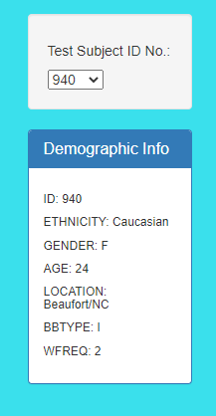
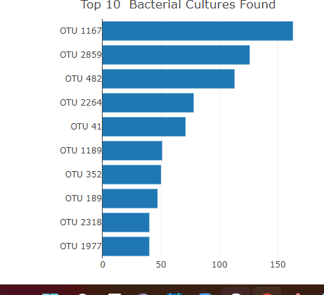
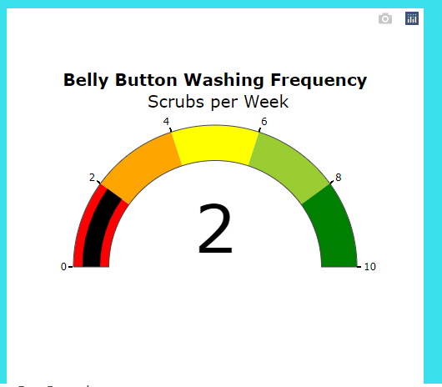
Option 1: HTML page similar to Plotly Belly button
Cuisine
info
Title and image of page
Machine learning image
Map of restaurants
Rating gauge
Top rated restaurants

Slide 8
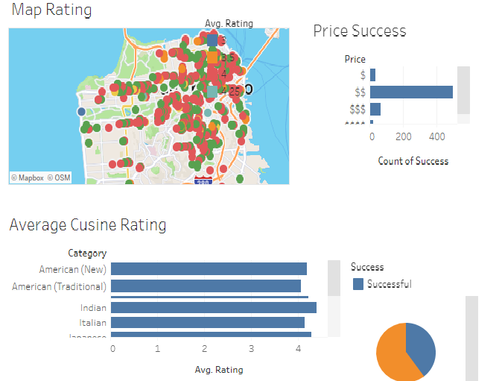
Option 2: Tableau Dashboards

